Slide 1
SAP EWM EXTENDED WAREHOUSE MANAGEMENT TRAINING
AnubhavTrainings.com
www.anubhavtrainings.com

Slide 2

SAP EWM TRAINING
BY:-
Mr. Bijoy
www.anubhavtrainings.com
Notes:
https://unsplash.com/photos/uXB-7la5vqA

Slide 3
SAP EWM TRAINING (Day 16)
AnubhavTrainings.com

Slide 4
Yard Management
Storage type & storage section for Yard, Yard setup, Define Checkpoints, Staging areas & Door determination group to door
Define Doors, Assign Staging area to Doors, Control parameters for Forming Vehicle, Number range for Transportation unit
Testing of end to end Inbound process with integration of Yard Management

Slide 5
Serial Number Management
Serial number profile plays an important role in the warehouse to track the material by serial number.
Character string that is given to a product in addition to a product number in order to differentiate the individual piece from all the other pieces. The combination of product number and serial number is unique.
The main difference between batch and serial numbers is that batch numbers are used for a group of products manufactured at the same time. Serial numbers are unique numbers assigned to specific items.
ERP Side Configuration -
Determine serial number profile
IMG-Logistics Execution-Shipping-Basic Shipping Functions-Serial Numbers-Determine Serial Number Profiles

Slide 6
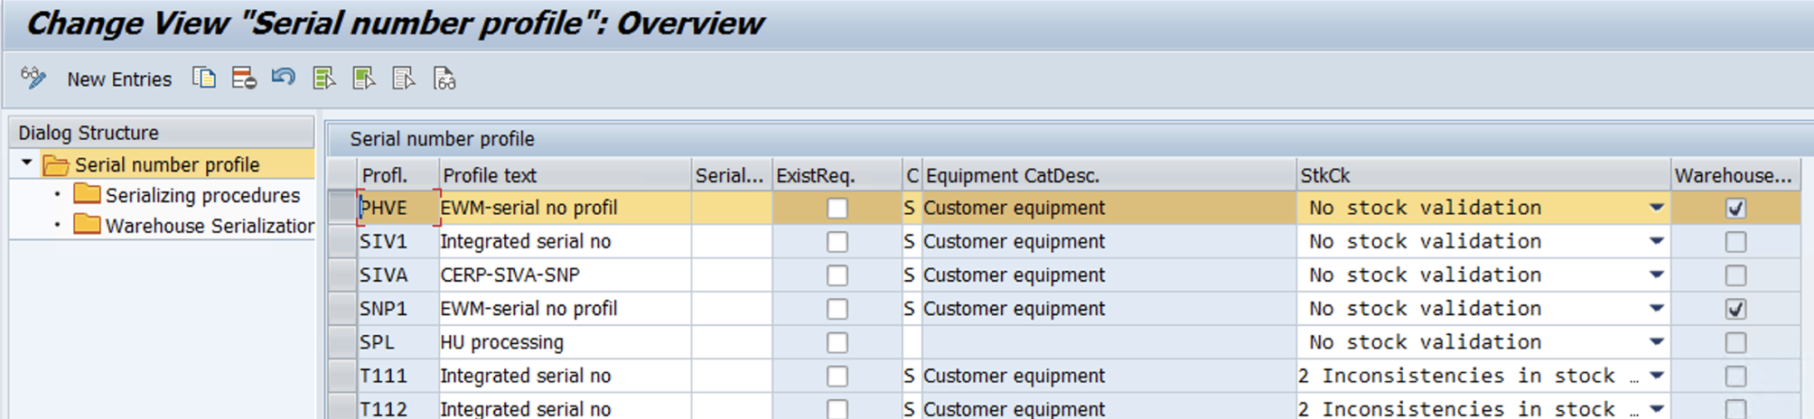
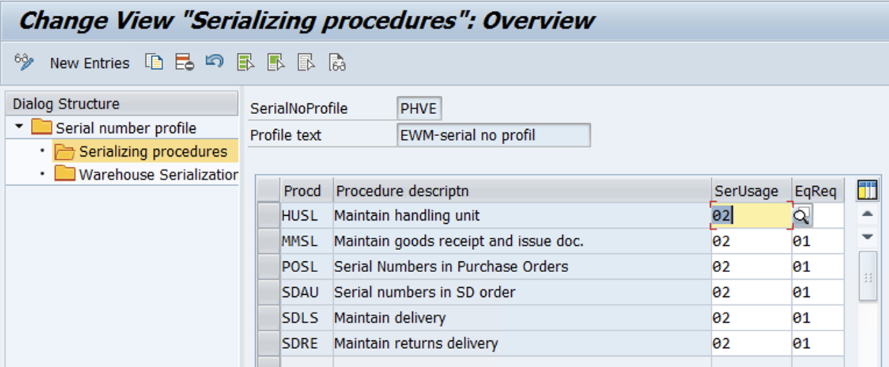

Slide 7
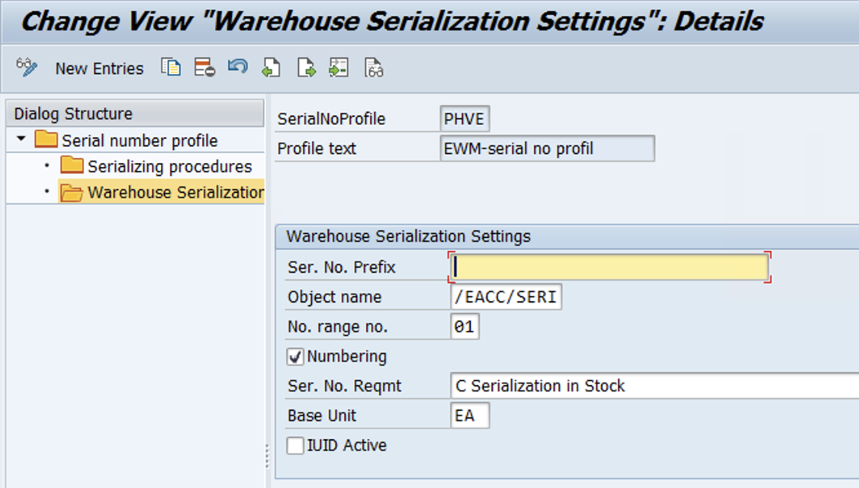

Slide 8
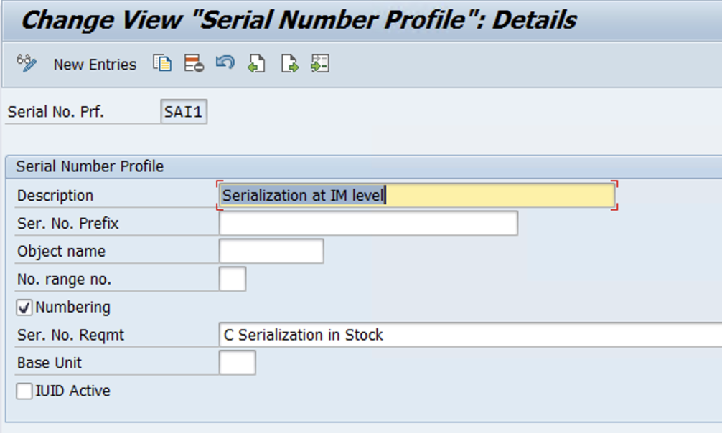
EWM relevant serial number profile
IMG - Integration with Other SAP Components- Extended Warehouse Management- Additional Material Attributes- Attribute Values for Additional Material Master Fields- Define Serial Number Profile
www.anubhavtrainings.com

Slide 9
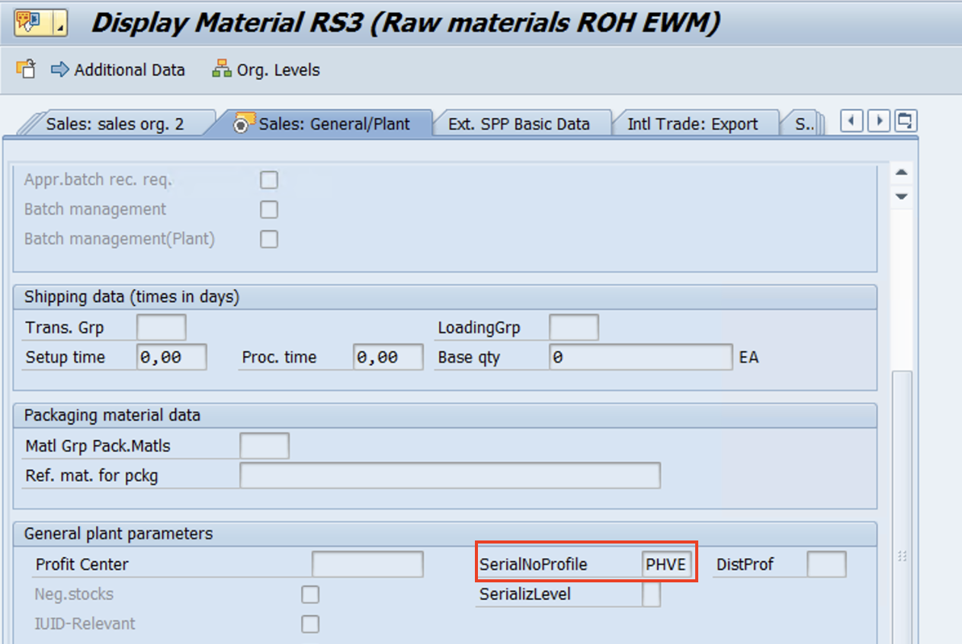
Serialization at IM level
Create Material – maintain Sales general data & WM execution views
www.anubhavtrainings.com

Slide 10
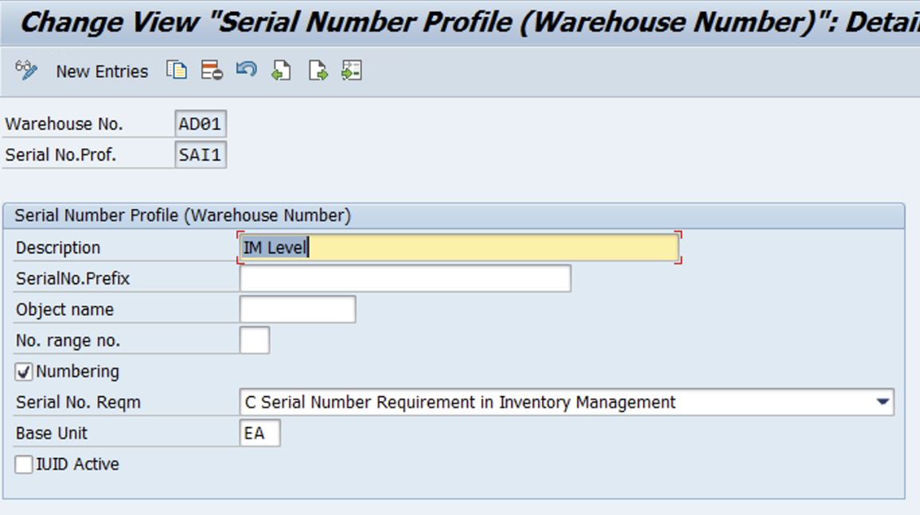
Define Warehouse Number-Dependent Serial Number Profiles
IMG- SCM Extended Warehouse Management- Extended Warehouse Management- Master Data-Product- Define Serial Number Profile-Define Warehouse Number-Dependent Serial Number Profiles

Slide 11
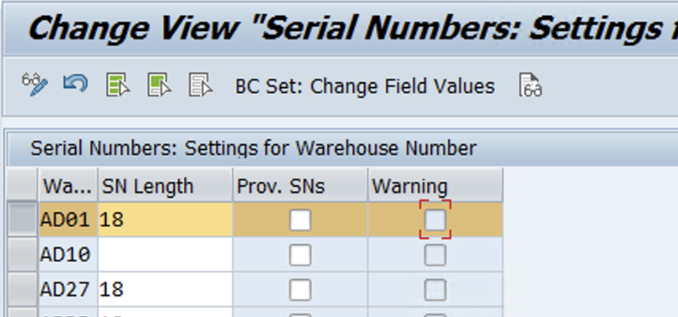
Settings for Warehouse Number
IMG- SCM Extended Warehouse Management- Extended Warehouse Management- Master Data-Product- Serial Number Profile – Setting for Warehouse number

Slide 12
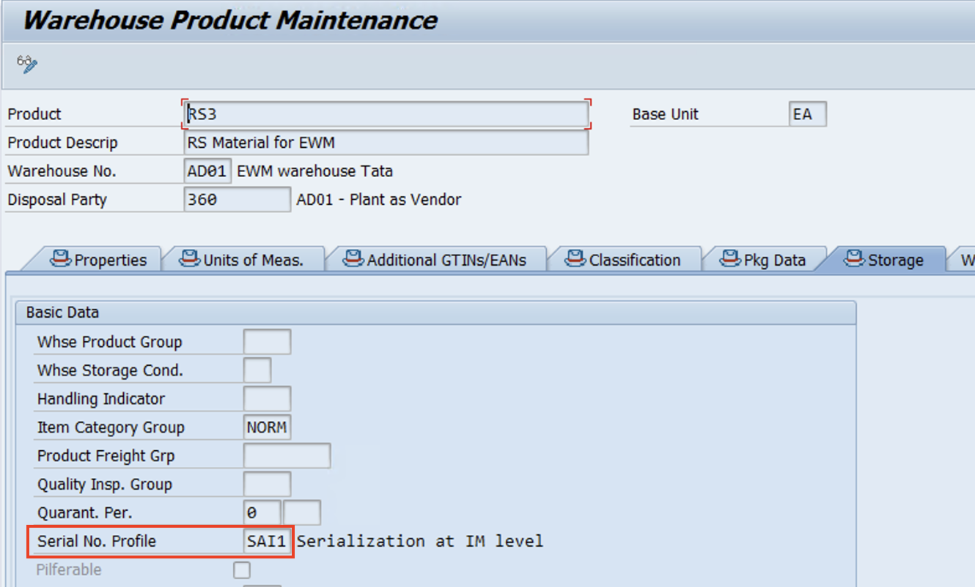
Maintain Warehouse Product master

Slide 13
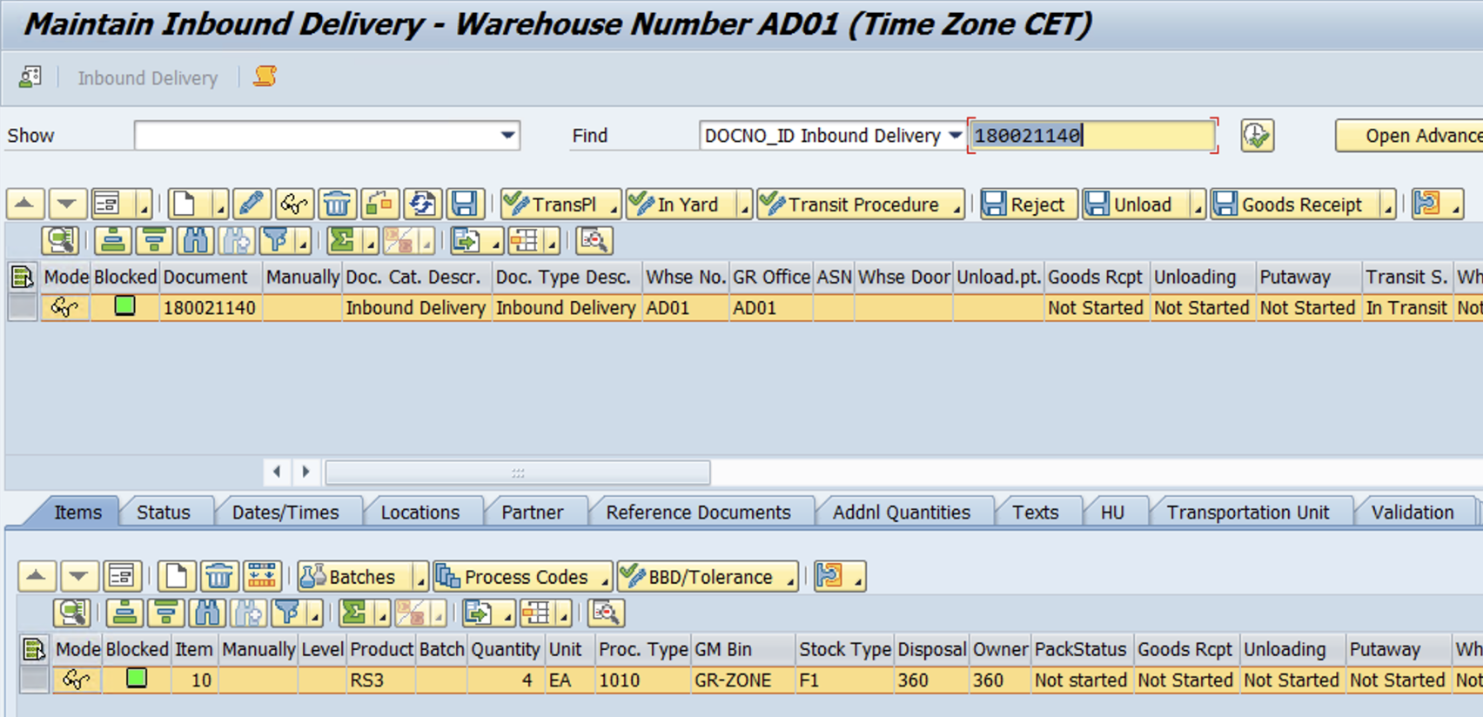
Test Case
Inbound Delivery
www.anubhavtrainings.com

Slide 14
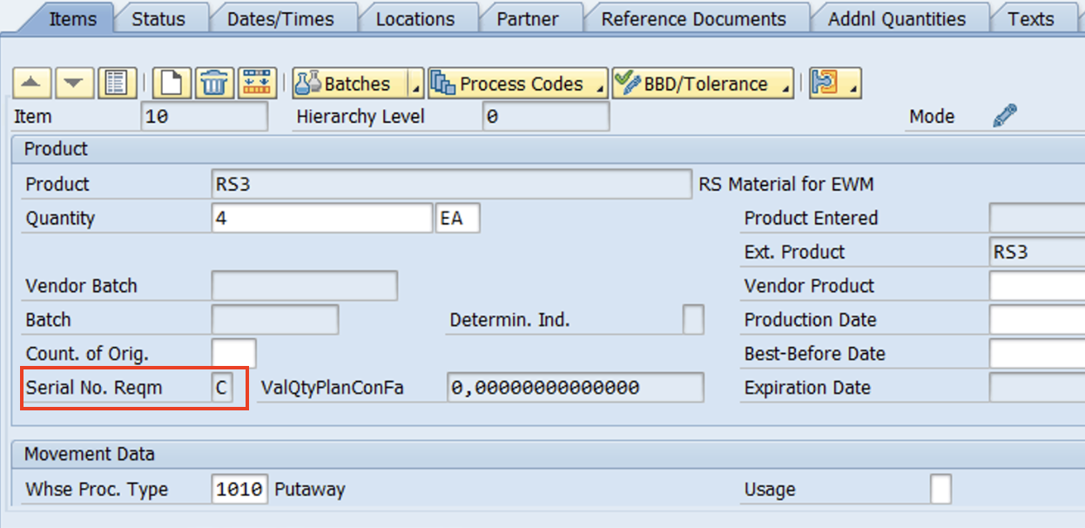
Enter Serial Number
www.anubhavtrainings.com

Slide 15
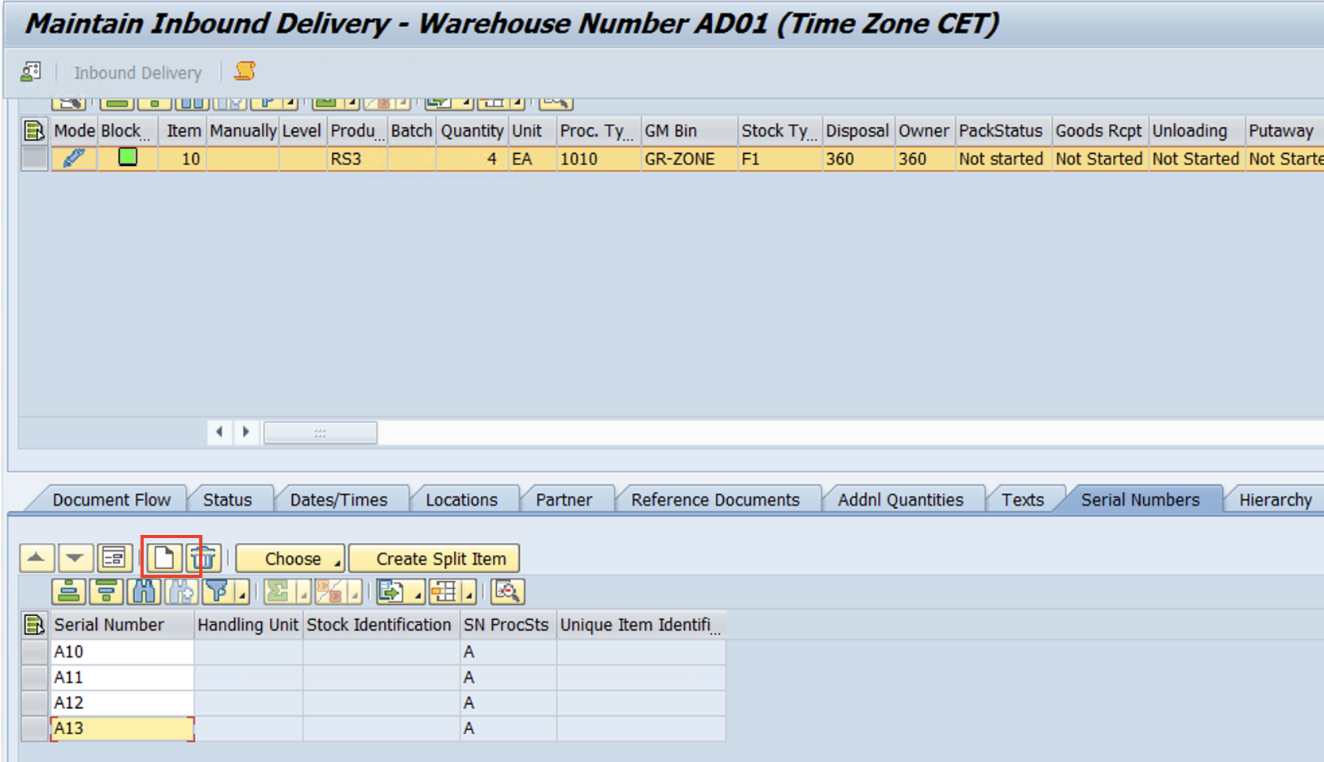
www.anubhavtrainings.com

Slide 16
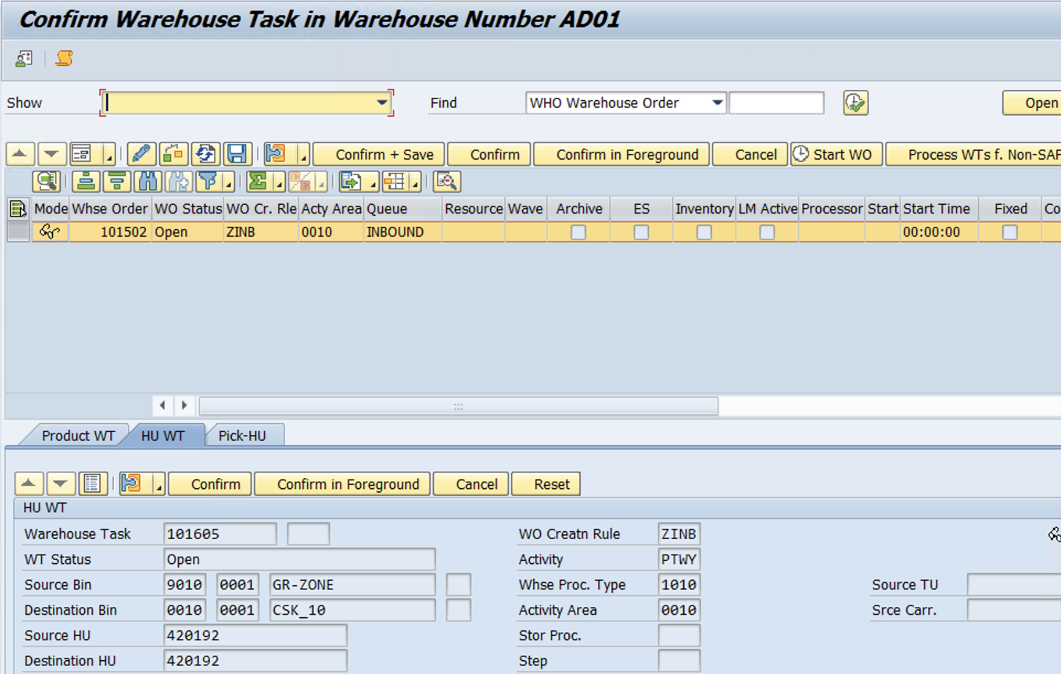
Packing >> GR >> Create Warehouse Tasks
www.anubhavtrainings.com

Slide 17


End of Session 16
www.anubhavtrainings.com

Slide 18

FEEL FREE TO ASK QUESTIONS

Slide 19

Feedback

Slide 20
THANK
YOU

Slide 21




More from AnubhavTrainings.com

Slide 22






We’re committed to empower you to be
#FutureReady
through powerful training solutions.
We build the workforce of the future.
250+
Corporate Clients
30,000+
Learners Trained
25000+
Learners Placed
FREE WEBINARS
Sign up for free webinars with industry experts every fortnight!
Enroll Now!

Slide 23
FREE WEBINARS
Sign up for free webinars with industry experts every fortnight!
Contact us today!
www.anubhavtrainings.com

